Slide 1

Vision-based Judgment of Tomato Maturity
Using Extreme Learning Machines
Roberto D. Saldaña Jr.
2009-09630
October 16, 2013

Slide 2
Outline
Introduction
Literature Review
Statement of the Problem
Objectives
Proposed Approach
Experiments and Results
Conclusion and Future Works

Slide 3
Introduction

Slide 4
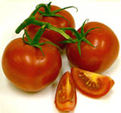
Tomato
Lycopersicon esculentum
Spanish word, tomate
Economically important fruit

Slide 5
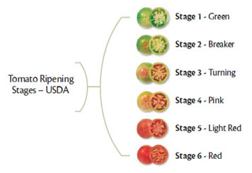
Tomato Maturity Stages

Slide 6
Why Automate?
Time consuming, tedious and expensive
Affected by sensations
Saving time and expenses
Improved quality, abolish inconsistency, reduce dependence

Slide 7
Digital Image
Electronic representation
Composed of pixels

Slide 8


Grayscale Image
O to 255, 8 bits
Luminance method

Slide 9
Binary Image
0 and 1 (255)
Otsu Thresholding

Slide 10
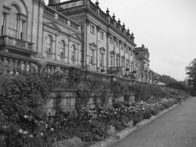
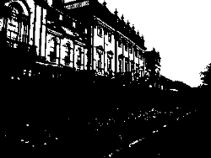
Otsu Thresholding
Nobuyuki Otsu
foreground and background

Slide 11
Image Processing
Manipulation of an image
2 purpose:
Improving visual appearance
Preparing images for measurement

Slide 12


Scaling
Resizing (increases or decreases)
efficiency vs smoothness vs sharpness

Slide 13


Cropping
Removal of parts

Slide 14
Color Space
Color Model
Mathematical or Numerical representation
RGB, HSI, CIE L*a*b*

Slide 15
RGB Color Space
Red, Green and Blue color space
Most basic and well-known
Widely used
Fails in dealing with “real world” images

Slide 16


HSI Color Space
More “intuitive”
Hue (H), Saturation (S), Intensity (I)

Slide 17





CIE L*a*b* Color Space
Uniform color model
L* = Lightness, a* and b* = chrominance

Slide 18
Neural Networks
Information processing diagram
Collection of neuron
Extract patterns, detect trends
Superior generalization capability
Slow learning speed

Slide 19
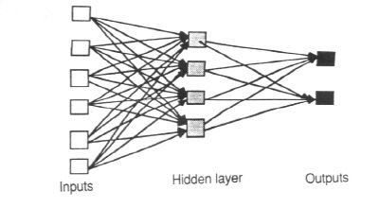
Multilayer Perceptron

Slide 20
Extreme Learning Machines
Huang et al
Tries to solve:
Intensive human intervention
Slow learning speed
“generalized” single-hidden layer feed-forward networks (SLFNs)

Slide 21
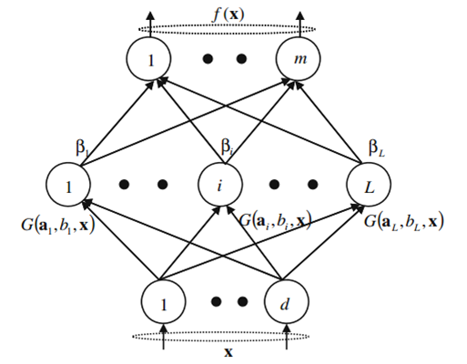
SLFN

Slide 22


Log-Sigmoid Function

Slide 23
Extreme Learning Machines
Given:
- a training set
- hidden node output function
- hidden node number L,
1. Randomly generate hidden node parameters ( ), i = 1 ,…, L.
2. Calculate the hidden layer output matrix H.
3. Calculate the output weight vector β: β = H⁺T

Slide 24



Extreme Learning Machines
N : number of Training Samples
L : number of Hidden nodes
m: number of Output nodes

Slide 25
Moore-Penrose

Slide 26


Regularization Coefficient

Slide 27
Literature Review

Slide 28
Literature Review
Lopez Camelo, A., Gomez P.: Comparison of color indexes for tomato ripening (2004)
Colorimeters, Tomato Ripening
Asadollahi, H., Kamarposhty, M., Teymoori, M.: Classification and Evaluation of Tomato Images Using Several Classifier (2009)
MLP, Random tree classifier, Tomato Classification

Slide 29
Literature Review
Iraji, M., Tosinia, A.: Classification Tomatoes on Machine Vision with Fuzzy the Mamdani Inference, Adaptive Neuro Fuzzy Inference System Based (Anfis-Sugeno) (2011)
FIS, ANFIS, Tomato Classification
Wang, X., Mao, H., Han, X., Yin, J.: Vision-based judgment of tomato maturity under growth conditions (2011)
near-infrared images, RGB/HSI Images, Tomato Classification

Slide 30
Literature Review
Van de Poel, B., Bulens, I., Hertog, M., Van Gastel, L., De Proft, M., Nicolai, B., Geeraerd, A.: Model-based classification of tomato fruit development and ripening related to physiological maturity (2012)
Model-based approach, Tomato Classification
Fojlaley M., Moghadam, P., Nia, S.: Tomato Classification and Sorting with machine vision using SVM, MLP, and LVQ (2012)
LVQ, MLP, SVM, Tomato Classification

Slide 31
Literature Review
Minhas, R., Mohammed, A., Wu, J.: A fast recognition framework based on extreme learning machine using hybrid object information. Neurocomputing (2010)
ELM, Object detection and categorization
Huang, G.B., Ding, X., Zhou, H.: Optimization method based extreme learning machine for classification (2010)
ELM, Classification problems

Slide 32
Literature Review
Huang, G.B., Zhou, H., Ding, X., Zhang, R.: Extreme Learning Machine for Regression and Multiclass Classification (2012)
ELM, Regression and Multiclass problems

Slide 33
Statement of the
Problem

Slide 34
Statement of the Problem
The traditional way of sorting and classification of tomatoes is a very time consuming, tedious, and expensive task. The automation of this task offers a lot of benefits such as reduced identification time, more consistent classification, and improved quality of tomato products which is a necessity in industrial applications.

Slide 35
Objectives

Slide 36
Objectives
To assess the performance of ELM in the evaluation of tomato maturity.
To determine the effect of varying the parameters of ELM such as the number of hidden nodes.

Slide 37
Objectives
To determine the effect of introducing a regularization coefficient to the performance of ELM in the judgment of tomato maturity.
To determine the effect of using the components L*, a*, Hue, red-green difference from the three color models (RGB, HSI, CIE L*a*b*) as inputs to the ELM network.

Slide 38
Proposed Approach

Slide 39
Pipeline of TomatoX
Scaling
Blue Channel
Grayscale Conversion
Masking
Cropping
Feature Extraction
ELM Training
Tomato Classification
Tomato Image

Slide 40
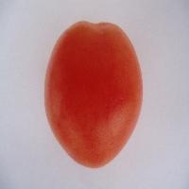
Tomato Image

Slide 41
Scaling

Slide 42
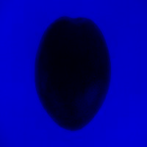

Blue Channel

Slide 43
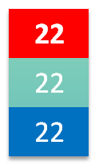

Grayscale Conversion

Slide 44


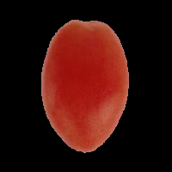
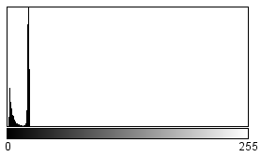

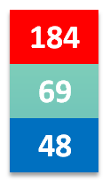
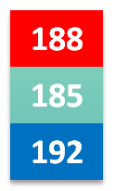
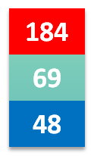
Masking

Slide 45
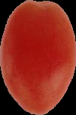
Cropping

Slide 46
Feature Extraction
R-G = 118.97
L* = 40.52
a* = 46.48
H = 6.16

Slide 47
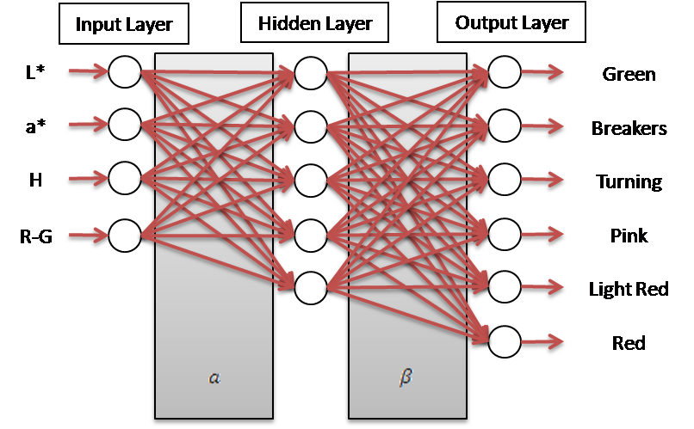
ELM Network Structure

Slide 48




ELM Training
Given:
R-G = 118.97
L* = 40.52
a* = 46.48
H = 6.16

Slide 49
Tomato Classification
Given:

Slide 50
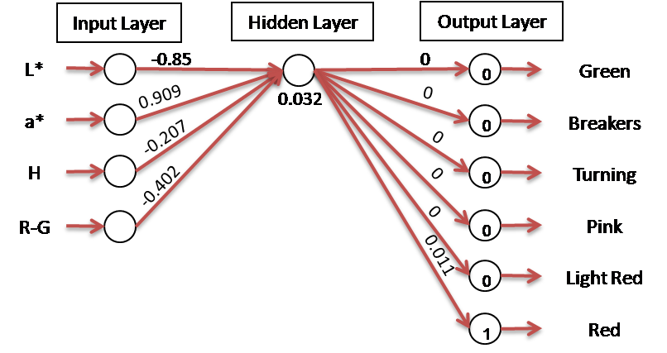
Tomato Classification

Slide 51
Experiments and Results

Slide 52
System Specifications
Hardware
AMD E-350 Processor 1.60 GHz
2.00 GB of RAM
Software
Microsoft Windows 8 Pro 64-bit (6.2, Build 9200)
Eclipse Juno IDE
Java Virtual Machine

Slide 53
Experimental Settings
Dataset = six hundred (600) images
One hundred (100) images per tomato stage
Train set
70% of dataset
Test set
30% of dataset

Slide 54
Standard Configuration
Parameter | Standard Value
Number of Hidden Nodes | 105
Regularization Coefficient (C) | Not set

Slide 55
Experiments
Experiment I
Comparison of fixed and random dataset
Experiment II
Variation in the number of hidden nodes
Experiment III
Variation in the values of the regularization coefficient
Experiment IV
Variation in the number of input color features

Slide 56
Experiment I
 | Fixed |  | Random
 | Test set | Train set | Test set | Train set
Mean | 97.593% | 98.865% | 97.185% | 98.905%

Slide 57
Experiment II
N, 0.75N, 0.5N, 0.25N
N = number of samples
Set | Number of Hidden Nodes
A | 105
B | 210
C | 315
D | 420

Slide 58
Experiment II
 | A | B | C | D
Mean | 97.593% | 96.796% | 94.667% | 87.463%

Slide 59
Experiment II
 | A | B | C | D
Mean | 98.865% | 99.556% | 99.714% | 99.952%

Slide 60
%
Experiment III
 | No C | 1 | 10 | 20 | 30 | 40 | 50
Mean | 97.593% | 98.259% | 98.13% | 98.074% | 98.056% | 98.148% | 98.28%

Slide 61
Experiment IV
Set | Color Feature (s)
A | R-G
B | H, R-G
C | L*, a*
D | L*, a*, H, R-G
E | R, G, R-G, H, a

Slide 62
Experiment IV
 | A | B | C | D | E
Mean | 96.037% | 94.444% | 96.741% | 97.593% | 95.833%

Slide 63
Benchmark
 | Current Research | TotoBee
Accuracy | 97.593% | 98.19 %
Training Time (sec) | 1.89 | 153.46

Slide 64
Conclusion and
Future Works

Slide 65
Conclusions
ELM classifier is robust
The number of hidden nodes can affect the performance of ELM
The introduction of a regularization coefficient (C) further improves the performance of ELM

Slide 66
Conclusions
The proposed input features (L*, a*, Hue, r-g) performed well
ELM can be an efficient method in the classification of tomatoes

Slide 67
Future Work
Extension to real-time tomato classification
Online-Sequential ELM (OS-ELM)
Other vegetables or fruits such as bananas

Slide 68
DEMO

